Slide 1
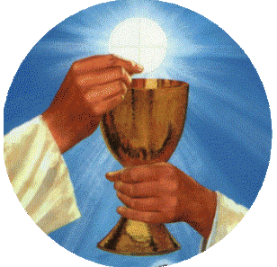
Saturday, 22 October 2011 – Dawn until 3.00 PM

Slide 2
When is the Lay Fast for Priests?
SATURDAY, 22 OCTOBER 2011
FROM DAWN UNTIL 3.00 PM
SIXTH, ANNUAL, GLOBAL DAY OF FAST AND PRAYER
OFFERED IN COMMON WITH THE WHOLE BODY OF CHRIST
LAY PEOPLE FAST FOR OUR PRIESTS
PAST – PRESENT - AND FUTURE!

Slide 3
Why fast?
“…prayer united with fasting is the most powerful
force in human history.” – Blessed John Paul II
Fasting creates an impenetrable force around the one prayed for.
Priests give us the Eucharist, and because all that is evil hates the Eucharist.
Priests need the power of our prayers.
Fasting is praying with the body.

Slide 4
Why fast for priests?
The Eucharist,
brought to us by the priest,
has immense power.
It is the
“source and summit”
(Lumen Gentium)
of our Catholic life.

Slide 5
The Eucharist
Jesus Christ told St Gertrude that for every Eucharist we receive with devotion, He will send a Saint to comfort us at our death.
St Bridget of Sweden teaches us that at the moment of Consecration, numberless angels come down and surround and look upon the priest, bowing toward him in reverential awe as he holds high the body of Christ.
All evil takes flight in terror.

Slide 6
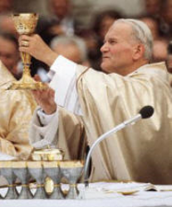
Oneness in Time
Blessed John Paul II taught us that during the Consecration, all time meets in the Eucharist.
A mysterious “oneness in time”
(Ecclesia de Eucharistia)
happens and we are drawn into the mind and person of Christ present, on Calvary yet also mysteriously present at the Resurrection.
Everyone who ever was and who has died in
“the grace and friendship of God” (Article 988 CCC) now lives in Christ .

Slide 7
No priest, no Eucharist
The priest lends his voice to Christ at the Consecration and the Lord becomes present to us.
Without the priest, we would not have the Eucharist.
God the Father told St Catherine of Siena that priests are His “Christs” (The Dialogue).

Slide 8
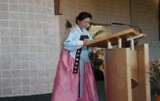
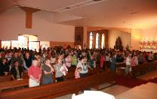
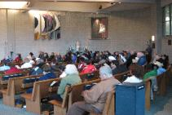
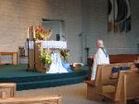
Where is the Lay Fast taking place?
Everywhere!
Many countries have written their support of our fast.
Taiwan Philippines India
South Korea China Iraq
South Africa Spain Ireland
Scotland England Italy
Haiti Poland Hong Kong
Canada New Zealand Russia
United States Said Arabia Brazil
Argentina Australia Wales
ASIA
AFRICA
NORTH AMERICA
EUROPE

Slide 9
What form should my Fast take?
We fast from the time we get out of bed
until the 3.00 PM Hour – the time of Christ’s death.
We fast from whatever we can – food or TV or computer. etc
We close our fast with a private prayer at 3.00 PM.

Slide 10
How do I sign up for the Fast?
The Sign Up sheets are at the back of the Church.
If you would like to join us just write down your name
and what you would like to fast from and
put the slip in the basket at the back of the church
or sign up online at www.annaprae.com

